Slide 1
Thalassemia
Dr. Ali Khazaal Jumaa
F.I.B.M.S (Int. Medicine) , F.I.B.M.S (Hematology)

Slide 2
DEFINITION
Thalassemias are inherited blood disorders characterized by defect in the rate of synthesis of one of the globin chains.
Resultant imbalance of globin chain production may cause ineffective erythropoiesis, defective Hb production, red cell Hb precipitates, hemolysis, anemia of variable degree and propensity to iron overload.
Each Hb molecule consists of two separate pairs of identical globin chains.
All normal human Hb molecules found in an adult have one pair of α-chains.
The α-chains can combine with:
β-chains (α2β2) : Hb A (97% of adult Hb)
δ-chains (α2δ2) : Hb A2 (2.5% of adult Hb)
γ-chains (α2γ2) : Hb F (0.5% of adult Hb)

Slide 3
There are two main types, alpha thalassemia and beta thalassemia. The severity of alpha and beta thalassemia depends on how many of the four genes for alpha globin or two genes for beta globin are missing.
The β globin chains are encoded by a single gene on chromosome 11; α globin chains are encoded by two closely linked genes on chromosome 16.

Slide 5
Beta Thalassemia
Beta thalassemia is inherited as an autosomal recessive disorder. The defect can be a complete absence of the beta-globin protein (Beta-zero thalassemia) or a severely reduced synthesis of the beta-globin protein (Beta-plus thalassemia).
In beta thalassemia minor (beta thalassemia trait or heterozygous carrier-type), one of the beta-globin genes is defective, resulting in an approximately 50% decrease in the synthesis of the beta-globin protein with mild- moderate microcytic hypochromic anemia.
In beta thalassemia major (homozygous beta thalassemia), the production of the beta-globin chains is severely impaired because both beta-globin genes are mutated. The severe imbalance of globin chain synthesis (alpha >> beta) results in ineffective erythropoiesis and severe microcytic hypochromic anemia.

Slide 6
Pathophysiology
The molecular defects in β-thalassemia result in absent or reduced β-chain production while α-globin synthesis is unaffected. The imbalance in globin chain production leads to an excess of α-chains. The free α-globin chains are highly unstable and precipitate in red cell precursors, forming intracellular inclusions that interfere with red cell maturation.
There is a variable degree of intramedullary destruction of erythroid precursors (ineffective erythropoiesis) that characterizes all β-thalassemia. Those red cells that mature and enter the circulation contain α-chain inclusions that interfere with their passage through the microcirculation, particularly in the spleen.
The end result is an extremely rigid red cell with a shortened survival.

Slide 7
Thus, the anemia of β-thalassemia results from a combination
of ineffective erythropoiesis and hemolysis. It stimulates
erythropoietin production, which causes expansion of the
bone marrow and may lead to serious deformities of the skull
and long bones.
Because the spleen is being constantly infiltrated with
abnormal red cells, it hypertrophies. The resulting
splenomegaly, together with bone marrow expansion,
causes a major increase in plasma volume, which also
contributes to the anemia.

Slide 8
Why is there increase in Hb F ?
HbF production almost ceases after birth. However, some adult red cell precursors retain the ability to produce a variable amount of γ-chains. Because the latter can combine with excess α-chains to form HbF, cells which make relatively more γ-chains in the bone marrow are partly protected against the deleterious effect of α-chain precipitation.
In some cases, there is also a genuine increase in HbF production.

Slide 10
History and Physical Examination
In patients with beta thalassemia major, the physical findings are related to: - severe anemia
- ineffective erythropoiesis
- extramedullary hematopoiesis
- iron overload resulting from transfusion
and increased iron absorption.

Slide 11
- pallor
- jaundice
- the skull and other bones may be deformed secondary to erythroid
hyperplasia with intramedullary expansion and cortical bone
thinning
Thalassemia can result in maxillary enlargement and bossing of skull, leading to an appearance known as chipmunk face, along with increased spaces between teeth and malocclusion.

Slide 12
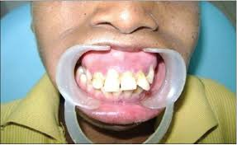

Slide 13
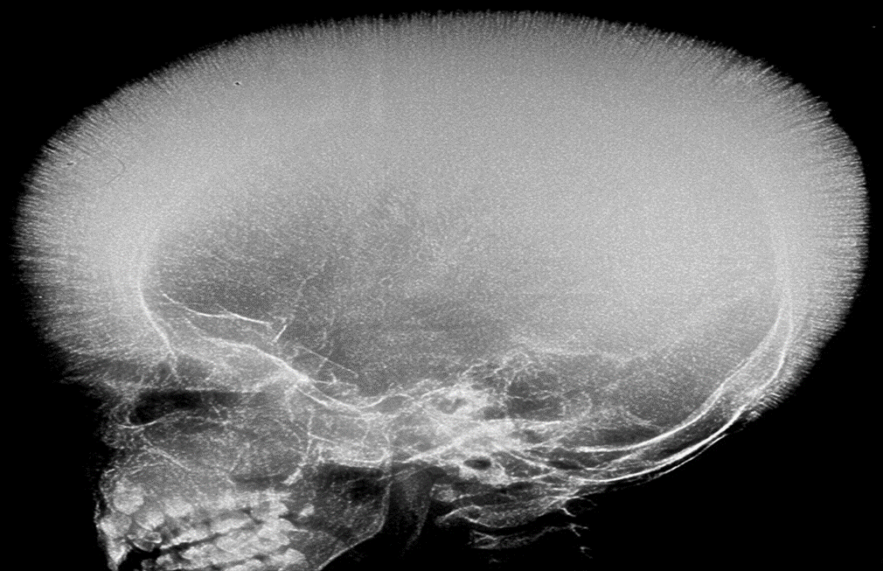
Expanded bone marrow space results in thinning of the bone cortex. These changes are particularly dramatic in the skull, which may show the characteristic “hair-on-end” appearance.

Slide 14
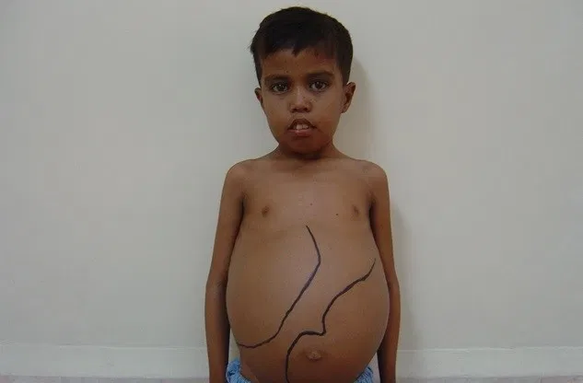
Abdominal examination:
Hepatomegaly is related to extramedullary hematopoiesis and iron overload.
The gallbladder may contain bilirubin stones formed as a result of the patient's lifelong hemolytic state.
Splenomegaly typically is observed as part of the extramedullary hematopoiesis or as a hypertrophic response related to the extravascular hemolysis.

Slide 15
Iron overload in thalassemia
Iron overload inevitably complicates regular blood transfusions
and is the source of many serious complications. Each unit of
transfused blood contains about 200–250 mg iron, compared
with the 1 mg iron normally absorbed each day.
Hepcidin, a peptide hormone produced primarily by the liver, is an
important negative regulator of iron absorption, but in thalassemia,
hepcidin levels remain inappropriately low, despite increased iron stores.

Slide 16
Tests of body iron overload
Serum ferritin: 12-300 ng/ml
Transferrin saturation :
(serum iron/total iron binding capacity) x 100
20-50 %
Liver Iron : biopsy, MRI

Slide 17
Complications of iron overload
- Cardiac : heart failure, cardiomyopathy, arrhythmia
- Hepatobiliary : liver failure, cirrhosis, hepatocellular carcinoma,
gall stones, cholecystitis
- Skin : pigmentation, ulcer
- Endocrine: . Growth hormone deficiency
. Delayed puberty, hypogonadism, infertility
. Diabetes mellitus
. Hypothyroidism
. Hypoparathyroidism (hypocalcemia)
- Bones and joints: arthropathies

Slide 18
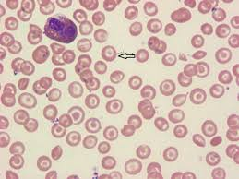
Laboratory Studies
. Microcytic hypochromic anemia
. Reticulocytosis
. Reactive leuko- and thrombocytosis
. B. film : target cells

Slide 19
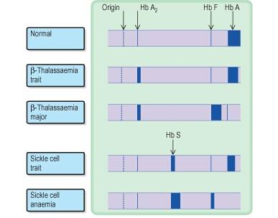
Hemoglobin electrophoresis

Slide 20
Evaluation for complications
. Iron study
. Echocardiography
. Liver function test, alfa fetoprotein
. Blood sugar
. Serum calcium
. Renal function test
. Thyroid function test
. LH, FSH

Slide 21
MANAGEMENT
Thalassemia minor
Patients with thalassemia minor usually do not require any specific treatment. Inform patients that their condition is hereditary and that physicians sometimes mistake the disorder for iron deficiency.

Slide 22
Thalassemia major
Treatment for patients with thalassemia major includes the following:
. Supportive measures (folic acid, regular monitoring for complications)
. Long-term transfusion therapy
. Iron chelation
. Splenectomy
. Allogeneic hematopoietic transplantation
. Erythroid maturation agents (eg, luspatercept)
. Gene therapy

Slide 23
Long-term transfusion therapy
The goal of long-term transfusional support is to maintain the patient's hemoglobin level at 9-10 g/dL, thus improving his or her sense of well being while simultaneously suppressing enhanced erythropoiesis. This strategy treats the anemia and suppresses endogenous erythropoiesis so that extramedullary hematopoiesis and skeletal changes are suppressed. Patients receiving long-term transfusion therapy also require iron chelation.
Blood banking considerations for these patients include transfusion of leuko-depleted RBC with complete typing for major and minor blood groups. This procedure helps future cross-matching processes and minimizes the chances of alloimmunization with subsequent hemolytic transfusion reactions.

Slide 24
Iron chelation
The body has no mechanism for excreting iron, and iron
chelating drugs are necessary to avoid toxic iron
accumulation.
Iron chelation is usually started after about 1 year of monthly
blood transfusions.
Currently, three drugs are used for iron chelation:
desferrioxamine, deferiprone and deferasirox.

Slide 26
Splenectomy
Physicians often use splenectomy to decrease transfusion requirements in patients with thalassemia major.
Indications:
. Annual transfusion requirement is greater than 200-250 mL RBCs/kg/y
. Hypersplenism with some degree of neutropenia or thrombocytopenia
. Inadequate control of body iron with optimal chelation therapy
. Huge splenomegaly with significant mechanical symptoms

Slide 27
Because postsplenectomy sepsis is possible, defer this procedure until the patient is older than 6-7 years.
In addition, to minimize the risk of postsplenectomy sepsis, vaccinate the patient against Pneumococcus species, Meningococcus species, and Haemophilus influenzae.
Administer penicillin prophylaxis to children after splenectomy.
Postsplenectomy thrombocytosis can increase the risk of thrombotic events.
The risk-to-benefit ratio for this procedure should be cautiously evaluated.

Slide 28
Other therapies:
- Allogeneic hematopoietic transplantation: may be curative in some patients with thalassemia major.
Gene therapy: In this process, autologous hematopoietic stem cells (HSCs) are harvested from the patient and then genetically modified. After the patient has undergone appropriate conditioning therapy to destroy existing HSCs, the modified HSCTs are reinfused into the patient. Clinical trials of gene therapy for thalassemia are currently recruiting participants.
Luspatercept, an erythroid maturation agent, is approved for anemia in adults with beta thalassemia who require regular red blood cell transfusions. Luspatercept improves hematology parameters associated with ineffective erythropoiesis.
Hydroxyurea : to induce Hb F
JAK2 inhibitors (Ruxolitinib) : to reverse splenomegaly

Slide 29
Genetic counseling
PREVENTION vs TREATMENT

Slide 30
Alpha THALASSEMIA
The alpha-globin genes are encoded on chromosome 16. Healthy individuals have 4 alpha-globin genes, 2 on each chromosome 16.
Alpha thalassemia syndromes are caused by deficient expression of 1 or more of the 4 alpha-globin genes on chromosome 16 and are characterized by absent or reduced synthesis of alpha-globin chains.

Slide 32
Subtypes of alpha thalassemia
1- Silent carrier: . one gene deletion (-α/αα)
. asymptomatic, or mild microcytosis
. Dx: genetic study
2- Alpha thalassemia trait (minor)
. Two gene deletions, either heterozygosity for alpha(0) thalassemia (αα/--) or homozygosity for alpha(+) thalassemia (-α/-α)
. The affected individuals are clinically normal but frequently have minimal anemia and reduced MCV and MCH.
. Dx : by exclusion, genetic study

Slide 33
3- Hemoglobin H disease (β4)
Deletion of 3 alpha-globin genes (-α/--) leads to a condition known as HbH disease, or alpha thalassemia intermedia. HbH is characterized by a high ratio of beta globin to alpha globin chains. The excess beta chains aggregate into tetramers (β4), which account for 5-40% of the hemoglobin level in patients with HbH disease.
This condition is characterized by a variable degree of anemia and splenomegaly, but it is unusual to find severe thalassemic bone changes or growth retardation. Patients usually survive into adult life, although the course may be interspersed with severe episodes of hemolysis associated with infection (eg, parvovirus B19) or worsening of the anemia due to progressive hypersplenism.
Hemoglobin values range from 70 to 100 g/L and the blood film shows typical thalassemic changes. Hemoglobin analysis reveals 5–40% HbH, 20-40% Hb Bart’s (4γ), together with HbA and a normal or reduced level of HbA2.

Slide 34
4- Hydrops fetalis (alpha thalassemia major)
Individuals with hydrops fetalis (--/--) have no functional alpha-globin chains and thus are unable to make functional hemoglobin.
Usually, they die in utero or shortly after birth.
The hemoglobin consists of approximately 80% Hb Bart’s and
20% Hb Portland (ζ2γ2).

Slide 35
Management
. Folic acid
. Transfusion therapy is reserved for patients with severe anemia (usually < 7 g/dL) and symptomatic anemia
. Iron chelation
. AlloSCT
. Splenectomy is reserved for patients with symptoms of hypersplenism (as reflected by leukopenia, thrombocytopenia, and worsening anemia) or for patients who were previously stable and have become a transfusion dependent.
. Prevention

